Slide 1
Basic Structures: Sets, Functions, Sequences, Sums, and Matrices
Chapter 2
With Question/Answer Animations
Copyright © McGraw-Hill Education. All rights reserved. No reproduction or distribution without the prior written consent of McGraw-Hill Education.

Slide 2
Chapter Summary
Sets
  The Language of Sets
  Set Operations
  Set Identities
Functions
  Types of Functions
  Operations on Functions
  Computability
Sequences and Summations
  Types of Sequences
  Summation Formulae
Set Cardinality
  Countable Sets
Matrices
  Matrix Arithmetic

Slide 3
Sets
Section 2.1

Slide 4
Section Summary
Definition of sets
Describing Sets
  Roster Method
  Set-Builder Notation
Some Important Sets in Mathematics
Empty Set and Universal Set
Subsets and Set Equality
Cardinality of Sets
Tuples
Cartesian Product

Slide 5
Introduction
Sets are one of the basic building blocks for the types of objects considered in discrete mathematics.
  Important for counting.
  Programming languages have set operations.
Set theory is an important branch of mathematics.
  Many different systems of axioms have been used to develop set theory.
  Here we are not concerned with a formal set of axioms for set theory. Instead, we will use what is called naïve set theory.

Slide 6
Sets
A set is an unordered collection of objects.
  the students in this class
  the chairs in this room
The objects in a set are called the elements, or members of the set. A set is said to contain its elements.
The notation a ∈ A denotes that a is an element of the set A.
If a is not a member of A, write a ∉ A

Slide 7
Describing a Set: Roster Method
S = {a,b,c,d}
Order not important
S = {a,b,c,d} = {b,c,a,d}
Each distinct object is either a member or not; listing more than once does not change the set.
S = {a,b,c,d} = {a,b,c,b,c,d}
Elipses (…) may be used to describe a set without listing all of the members when the pattern is clear.
S = {a,b,c,d, ……,z }

Slide 8
Roster Method
Set of all vowels in the English alphabet:
V = {a,e,i,o,u}
Set of all odd positive integers less than 10:
O = {1,3,5,7,9}
Set of all positive integers less than 100:
S = {1,2,3,……..,99}
Set of all integers less than 0:
S = {…., -3,-2,-1}

Slide 9
Some Important Sets
N = natural numbers = {0,1,2,3….}
Z = integers = {…,-3,-2,-1,0,1,2,3,…}
Z⁺ = positive integers = {1,2,3,…..}
R = set of real numbers
R⁺ = set of positive real numbers
C = set of complex numbers.
Q = set of rational numbers

Slide 10
Set-Builder Notation
Specify the property or properties that all members must satisfy:
S = {x | x is a positive integer less than 100}
O = {x | x is an odd positive integer less than 10}
O = {x ∈ Z⁺ | x is odd and x < 10}
A predicate may be used:
S = {x | P(x)}
Example: S = {x | Prime(x)}
Positive rational numbers:
Q⁺ = {x ∈ R | x = p/q, for some positive integers p,q}

Slide 11
Interval Notation
[a,b] = {x | a ≤ x ≤ b}
[a,b) = {x | a ≤ x < b}
(a,b] = {x | a < x ≤ b}
(a,b) = {x | a < x < b}
closed interval [a,b]
open interval (a,b)

Slide 12
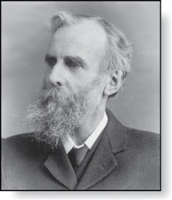
Universal Set and Empty Set
The universal set U is the set containing everything currently under consideration.
  Sometimes implicit
  Sometimes explicitly stated.
  Contents depend on the context.
The empty set is the set with no
elements. Symbolized ∅, but
{} also used.
Venn Diagram
U
V
a e i
o u
John Venn (1834-1923)
Cambridge, UK

Slide 13
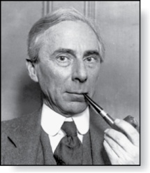
Russell’s Paradox
Let S be the set of all sets which are not members of themselves. A paradox results from trying to answer the question “Is S a member of itself?”
Related Paradox:
  Henry is a barber who shaves all people who do not shave themselves. A paradox results from trying to answer the question “Does Henry shave himself?”
Bertrand Russell (1872-1970)
Cambridge, UK
Nobel Prize Winner

Slide 14
Some things to remember
Sets can be elements of sets.
{{1,2,3},a, {b,c}}
{N,Z,Q,R}
The empty set is different from a set containing the empty set.
∅ ≠ { ∅ }

Slide 15
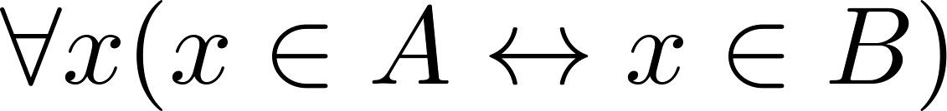
Set Equality
Definition: Two sets are equal if and only if they have the same elements.
  Therefore if A and B are sets, then A and B are equal if and only if .
  We write A = B if A and B are equal sets.
{1,3,5} = {3, 5, 1}
{1,5,5,5,3,3,1} = {1,3,5}

Slide 16
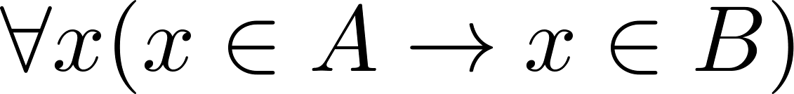
Subsets
Definition: The set A is a subset of B, if and only if every element of A is also an element of B.
  The notation A ⊆ B is used to indicate that A is a subset of the set B.
  A ⊆ B holds if and only if is true.
    Because a ∈ ∅ is always false, ∅ ⊆ S ,for every set S.
    Because a ∈ S → a ∈ S, S ⊆ S, for every set S.

Slide 17
Showing a Set is or is not a Subset of Another Set
Showing that A is a Subset of B: To show that A ⊆ B, show that if x belongs to A, then x also belongs to B.
Showing that A is not a Subset of B: To show that A is not a subset of B, A ⊈ B, find an element x ∈ A with x ∉ B. (Such an x is a counterexample to the claim that x ∈ A implies x ∈ B.)
Examples:
  The set of all computer science majors at your school is a subset of all students at your school.
  The set of integers with squares less than 100 is not a subset of the set of nonnegative integers.

Slide 18
Another look at Equality of Sets
Recall that two sets A and B are equal, denoted by A = B, iff
Using logical equivalences we have that A = B iff
This is equivalent to
A ⊆ B and B ⊆ A

Slide 19
Proper Subsets
Definition: If A ⊆ B, but A ≠B, then we say A is a proper subset of B, denoted by A ⊂ B. If A ⊂ B, then
is true.
Venn Diagram
U
B
A

Slide 20
Set Cardinality
Definition: If there are exactly n distinct elements in S where n is a nonnegative integer, we say that S is finite. Otherwise it is infinite.
Definition: The cardinality of a finite set A, denoted by |A|, is the number of (distinct) elements of A.
Examples:
|ø| = 0
Let S be the letters of the English alphabet. Then |S| = 26
|{1,2,3}| = 3
|{ø}| = 1
The set of integers is infinite.

Slide 21
Power Sets
Definition: The set of all subsets of a set A, denoted P(A), is called the power set of A.
Example: If A = {a,b} then
P(A) = {ø, {a},{b},{a,b}}
If a set has n elements, then the cardinality of the power set is 2ⁿ. (In Chapters 5 and 6, we will discuss different ways to show this.)

Slide 22
Tuples
The ordered n-tuple (a₁,a₂,…..,a_{n}) is the ordered collection that has a₁ as its first element and a₂ as its second element and so on until a_{n} as its last element.
Two n-tuples are equal if and only if their corresponding elements are equal.
2-tuples are called ordered pairs.
The ordered pairs (a,b) and (c,d) are equal if and only if a = c and b = d.

Slide 23
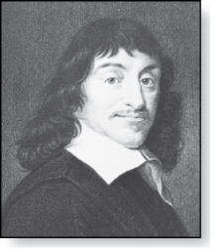
Cartesian Product
René Descartes (1596-1650)
Definition: The Cartesian Product of two sets A and B, denoted by A × B is the set of ordered pairs (a,b) where a ∈ A and b ∈ B .
Example:
A = {a,b} B = {1,2,3}
A × B = {(a,1),(a,2),(a,3), (b,1),(b,2),(b,3)}
Definition: A subset R of the Cartesian product A × B is called a relation from the set A to the set B. (Relations will be covered in depth in Chapter 9. )

Slide 24
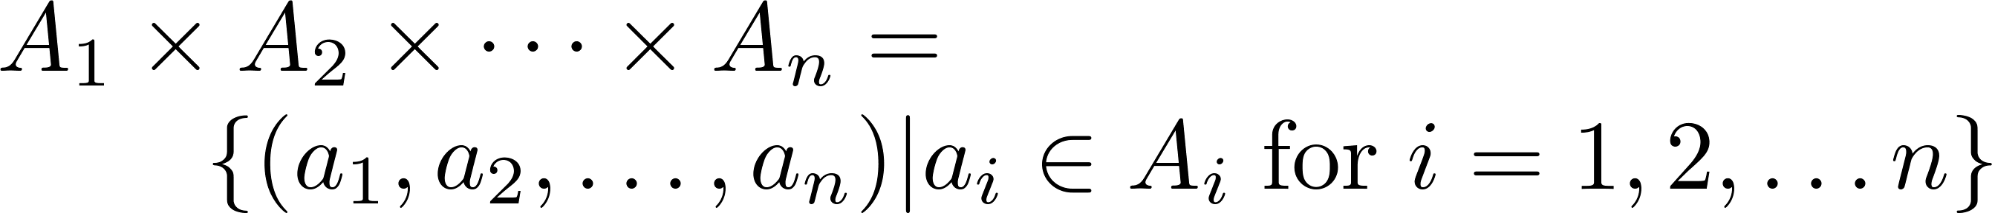
Cartesian Product
Definition: The cartesian products of the sets A₁,A₂,……,A_{n}, denoted by A₁ × A₂ × …… × A_{n} , is the set of ordered n-tuples (a₁,a₂,……,a_{n}) where a_{i} belongs to A_{i} for i = 1, … n.
Example: What is A × B × C where A = {0,1}, B = {1,2} and C = {0,1,2}
Solution: A × B × C = {(0,1,0), (0,1,1), (0,1,2),(0,2,0), (0,2,1), (0,2,2),(1,1,0), (1,1,1), (1,1,2), (1,2,0), (1,2,1), (1,2,2)}

Slide 25
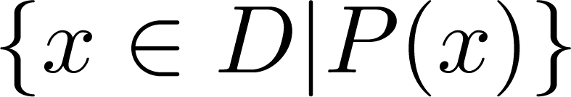
Truth Sets of Quantifiers
Given a predicate P and a domain D, we define the truth set of P to be the set of elements in D for which P(x) is true. The truth set of P(x) is denoted by
Example: The truth set of P(x) where the domain is the integers and P(x) is “|x| = 1” is the set {-1,1}

Slide 26
Set Operations
Section 2.2

Slide 27
Section Summary
Set Operations
  Union
  Intersection
  Complementation
  Difference
More on Set Cardinality
Set Identities
Proving Identities
Membership Tables

Slide 28
Boolean Algebra
Propositional calculus and set theory are both instances of an algebraic system called a Boolean Algebra. This is discussed in Chapter 12.
The operators in set theory are analogous to the corresponding operator in propositional calculus.
As always there must be a universal set U. All sets are assumed to be subsets of U.

Slide 29
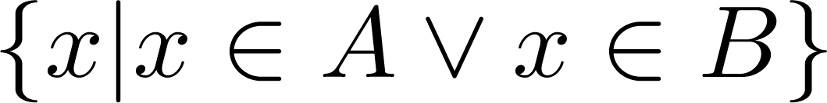
Union
Definition: Let A and B be sets. The union of the sets A and B, denoted by A ∪ B, is the set:
Example: What is {1,2,3} ∪ {3, 4, 5}?
Solution: {1,2,3,4,5}
Venn Diagram for A ∪ B
U
A
B

Slide 30
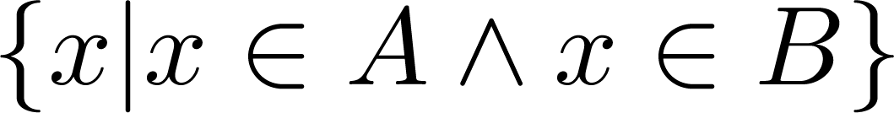
Intersection
Definition: The intersection of sets A and B, denoted by A ∩ B, is
Note if the intersection is empty, then A and B are said to be disjoint.
Example: What is? {1,2,3} ∩ {3,4,5} ?
Solution: {3}
Example:What is?
{1,2,3} ∩ {4,5,6} ?
Solution: ∅
Venn Diagram for A ∩B
U
A
B

Slide 31
Complement
Definition: If A is a set, then the complement of the A (with respect to U), denoted by Ā is the set U - A
Ā = {x ∈ U | x ∉ A}
(The complement of A is sometimes denoted by A^{c} .)
Example: If U is the positive integers less than 100, what is the complement of {x | x > 70}
Solution: {x | x ≤ 70}
Venn Diagram for Complement
U
Ā
A

Slide 32
Difference
Definition: Let A and B be sets. The difference of A and B, denoted by A – B, is the set containing the elements of A that are not in B. The difference of A and B is also called the complement of B with respect to A.
A – B = {x | x ∈ A ∧ x ∉ B} = A ∩‾B
U
Venn Diagram for A − B
A
B

Slide 33
The Cardinality of the Union of Two Sets
Inclusion-Exclusion
|A ∪ B| = |A| + | B| − |A ∩ B|
Example: Let A be the math majors in your class and B be the CS majors. To count the number of students who are either math majors or CS majors, add the number of math majors and the number of CS majors, and subtract the number of joint CS/math majors.
We will return to this principle in Chapter 6 and Chapter 8 where we will derive a formula for the cardinality of the union of n sets, where n is a positive integer.
U
A
B
Venn Diagram for A, B, A ∩ B, A ∪ B

Slide 34
Review Questions
Example: U = {0,1,2,3,4,5,6,7,8,9,10} A = {1,2,3,4,5}, B ={4,5,6,7,8}
  A ∪ B
    Solution: {1,2,3,4,5,6,7,8}
  A ∩ B
    Solution: {4,5}
  Ā
    Solution: {0,6,7,8,9,10}
    Solution: {0,1,2,3,9,10}
  A – B
    Solution: {1,2,3}
  B – A
    Solution: {6,7,8}

Slide 35

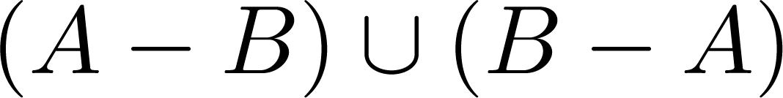
Symmetric Difference (optional)
Definition: The symmetric difference of A and B, denoted by is the set
Example:
  U = {0,1,2,3,4,5,6,7,8,9,10}
  A = {1,2,3,4,5} B ={4,5,6,7,8}
  What is :
  Solution: {1,2,3,6,7,8}
U
A
B
Venn Diagram

Slide 36



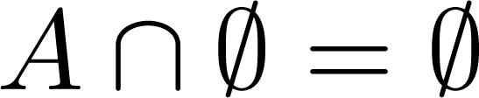


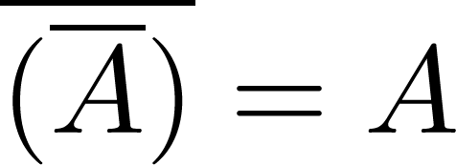
Set Identities
Identity laws
Domination laws
Idempotent laws
Complementation law
Continued on next slide →

Slide 37


Set Identities
Commutative laws
Associative laws
Distributive laws
Continued on next slide →

Slide 38


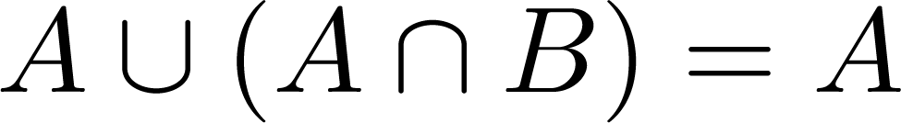
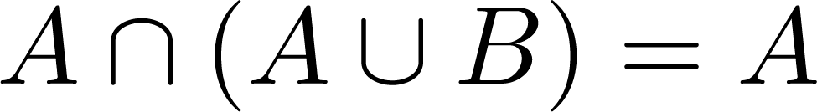

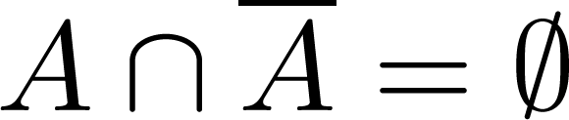
Set Identities
De Morgan’s laws
Absorption laws
Complement laws

Slide 39
Proving Set Identities
Different ways to prove set identities:
  Prove that each set (side of the identity) is a subset of the other.
  Use set builder notation and propositional logic.
  Membership Tables: Verify that elements in the same combination of sets always either belong or do not belong to the same side of the identity. Use 1 to indicate it is in the set and a 0 to indicate that it is not.

Slide 40
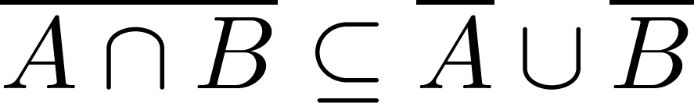

Proof of Second De Morgan Law
Example: Prove that
Solution: We prove this identity by showing that:
1) and
2)
Continued on next slide →

Slide 41
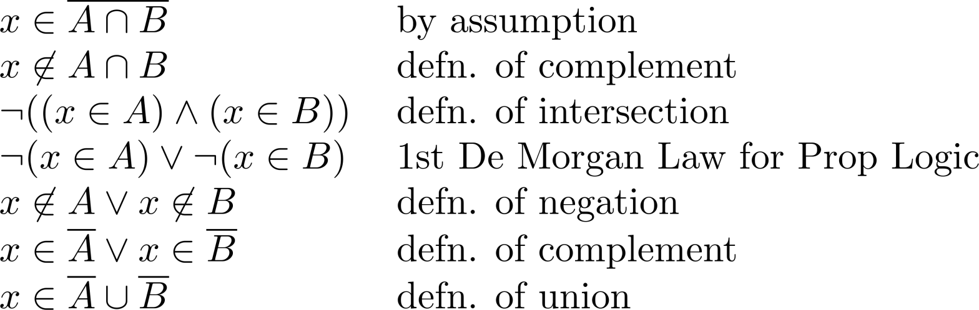
Proof of Second De Morgan Law
These steps show that:
Continued on next slide →

Slide 42
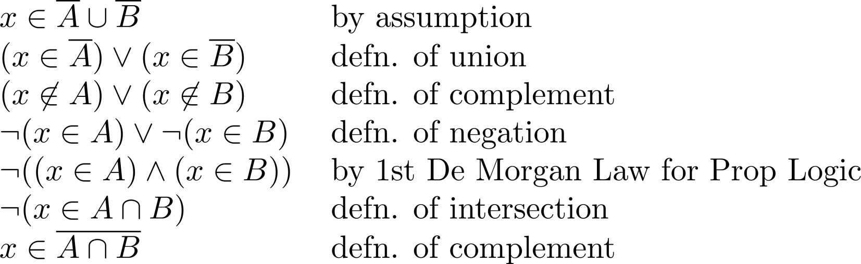
Proof of Second De Morgan Law
These steps show that:

Slide 43
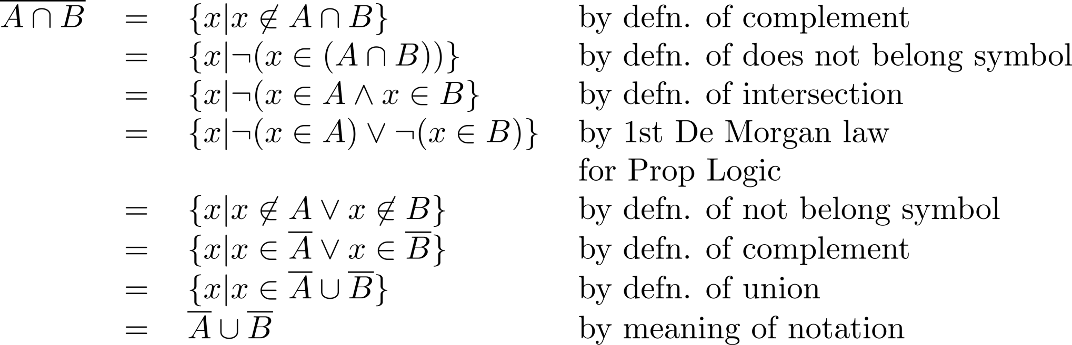
Set-Builder Notation: Second De Morgan Law

Slide 44





Membership Table
Example:
Construct a membership table to show that the distributive law holds.
Solution:
A | B | C
1 | 1 | 1 | 1 | 1 | 1 | 1 | 1
1 | 1 | 0 | 0 | 1 | 1 | 1 | 1
1 | 0 | 1 | 0 | 1 | 1 | 1 | 1
1 | 0 | 0 | 0 | 1 | 1 | 1 | 1
0 | 1 | 1 | 1 | 1 | 1 | 1 | 1
0 | 1 | 0 | 0 | 0 | 1 | 0 | 0
0 | 0 | 1 | 0 | 0 | 0 | 1 | 0
0 | 0 | 0 | 0 | 0 | 0 | 0 | 0

Slide 45
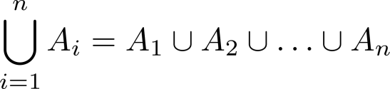
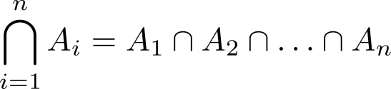
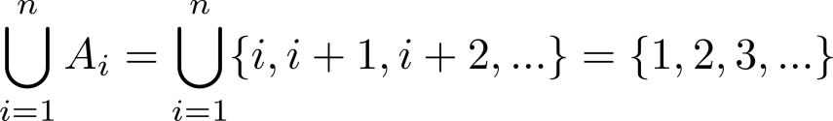
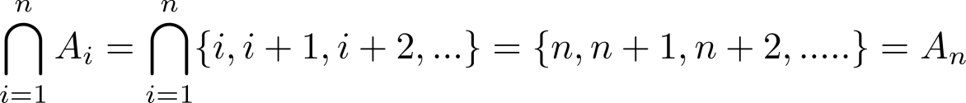
Generalized Unions and Intersections
Let A₁, A₂ ,…, A_{n} be an indexed collection of sets.
We define:
These are well defined, since union and intersection are associative.
For i = 1,2,…, let A_{i} = {i, i + 1, i + 2, ….}. Then,

Slide 46
Functions
Section 2.3

Slide 47
Section Summary
Definition of a Function.
  Domain, Codomain
  Image, Preimage
Injection, Surjection, Bijection
Inverse Function
Function Composition
Graphing Functions
Floor, Ceiling, Factorial
Partial Functions (optional)

Slide 48
Functions
Definition: Let A and B be nonempty sets. A function f from A to B, denoted f: A → B is an assignment of each element of A to exactly one element of B. We write f(a) = b if b is the unique element of B assigned by the function f to the element a of A.
Functions are sometimes
called mappings or
transformations.
Students
Grades
A
Carlota Rodriguez
B
Sandeep Patel
C
Jalen Williams
D
F
Kathy Scott

Slide 49
Functions
A function f: A → B can also be defined as a subset of A×B (a relation). This subset is restricted to be a relation where no two elements of the relation have the same first element.
Specifically, a function f from A to B contains one, and only one ordered pair (a, b) for every element a∈ A.
and

Slide 50
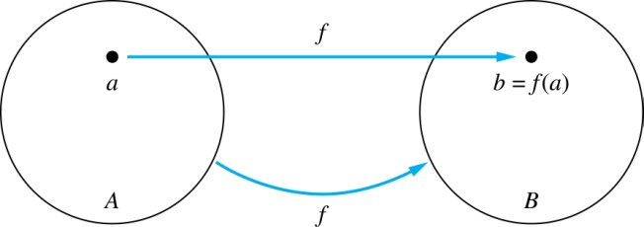
Functions
Given a function f: A → B:
We say f maps A to B or
f is a mapping from A to B.
A is called the domain of f.
B is called the codomain of f.
If f(a) = b,
  then b is called the image of a under f.
  a is called the preimage of b.
The range of f is the set of all images of points in A under f. We denote it by f(A).
Two functions are equal when they have the same domain, the same codomain and map each element of the domain to the same element of the codomain.

Slide 51
Representing Functions
Functions may be specified in different ways:
  An explicit statement of the assignment.
    Students and grades example.
  A formula.
    f(x) = x + 1
  A computer program.
    A Java program that when given an integer n, produces the nth Fibonacci Number (covered in the next section and also inChapter 5).

Slide 52
Questions
z
A
B
f(a) = ?
The image of d is ?
z
a
x
The domain of f is ?
A
b
y
The codomain of f is ?
B
c
d
z
The preimage of y is ?
b
f(A) = ?
{y,z}
The preimage(s) of z is (are) ?
{a,c,d}

Slide 53
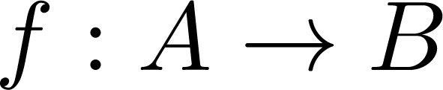
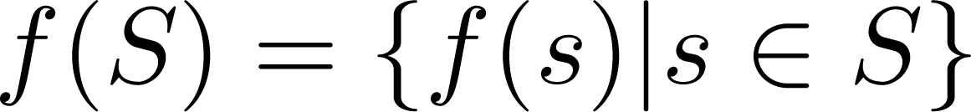
Question on Functions and Sets
If and S is a subset of A, then
A
B
f {a,b,c,} is ?
{y,z}
a
x
f {c,d} is ?
b
{z}
y
c
d
z

Slide 54

Injections
Definition: A function f is said to be one-to-one , or injective, if and only if f(a) = f(b) implies that a = b for all a and b in the domain of f. A function is said to be an injection if it is one-to-one.
A
B
a
x
v
b
y
c
z
d
w

Slide 55

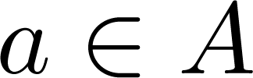
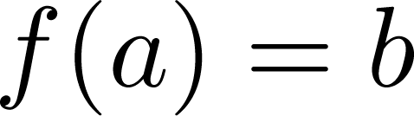
Surjections
Definition: A function f from A to B is called onto or surjective, if and only if for every element there is an element with . A function f is called a surjection if it is onto.
A
B
a
x
b
y
c
z
d

Slide 56
Bijections
Definition: A function f is a one-to-one correspondence, or a bijection, if it is both one-to-one and onto (surjective and injective).
A
B
a
x
b
y
c
d
z
w

Slide 57
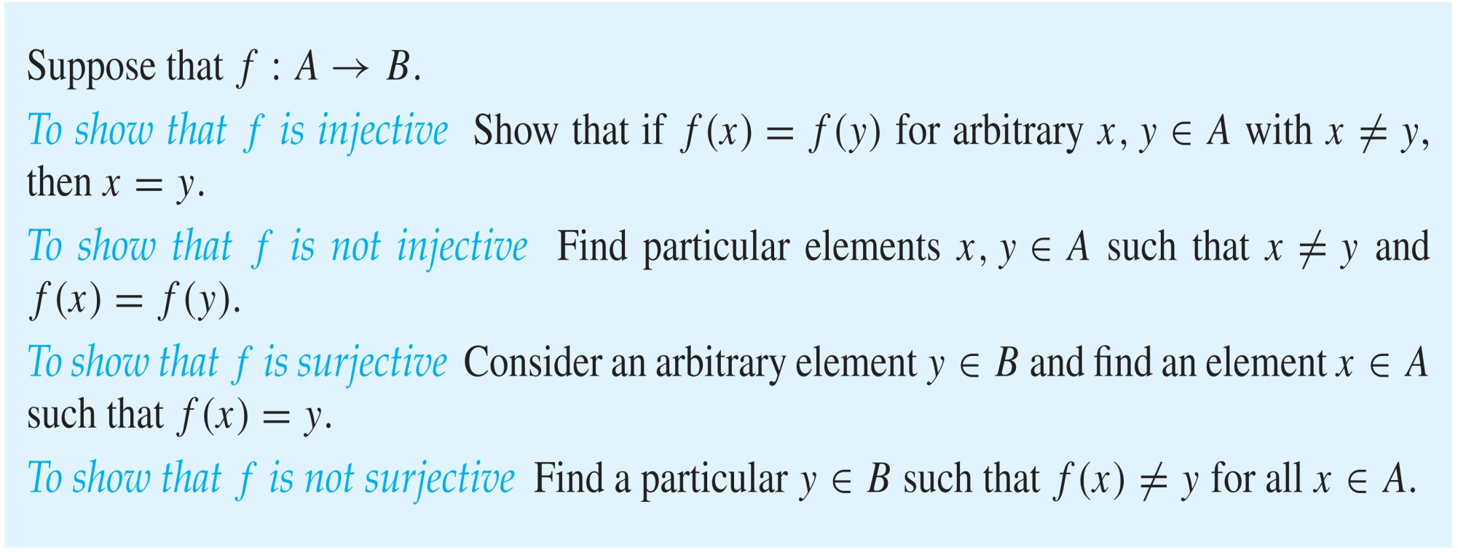
Showing that f is one-to-one or onto

Slide 58
Showing that f is one-to-one or onto
Example 1: Let f be the function from {a,b,c,d} to {1,2,3} defined by f(a) = 3, f(b) = 2, f(c) = 1, and f(d) = 3. Is f an onto function?
Solution: Yes, f is onto since all three elements of the codomain are images of elements in the domain. If the codomain were changed to {1,2,3,4}, f would not be onto.
Example 2: Is the function f(x) = x² from the set of integers to the set of integers onto?
Solution: No, f is not onto because there is no integer x with x² = −1, for example.

Slide 59
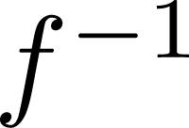
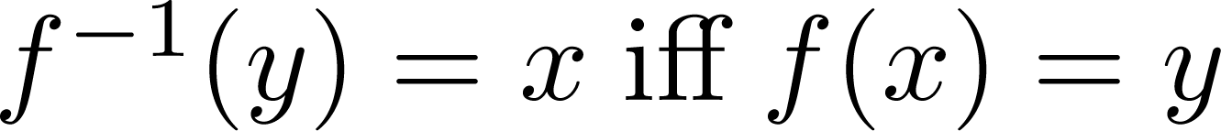
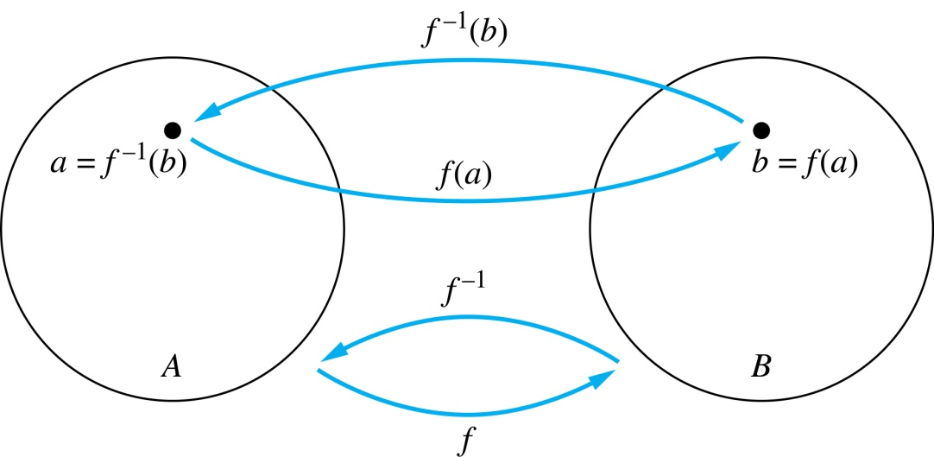
Inverse Functions
Definition: Let f be a bijection from A to B. Then the inverse of f, denoted , is the function from B to A defined as
No inverse exists unless f is a bijection. Why?

Slide 60
Inverse Functions
A
B
A
B
f
a
V
V
a
b
b
W
W
c
c
d
X
X
d
Y
Y

Slide 61
Questions
Example 1: Let f be the function from {a,b,c} to {1,2,3} such that f(a) = 2, f(b) = 3, and f(c) = 1. Is f invertible and if so what is its inverse?
Solution: The function f is invertible because it is a one-to-one correspondence. The inverse function f⁻¹ reverses the correspondence given by f, so f⁻¹ (1) = c, f⁻¹ (2) = a, and f⁻¹ (3) = b.

Slide 62
Questions
Example 2: Let f: Z → Z be such that f(x) = x + 1. Is f invertible, and if so, what is its inverse?
Solution: The function f is invertible because it is a one-to-one correspondence. The inverse function f⁻¹ reverses the correspondence so f⁻¹ (y) = y – 1.

Slide 63
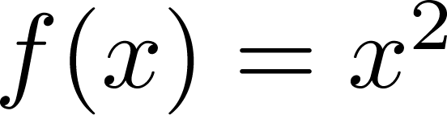
Questions
Example 3: Let f: R → R be such that . Is f invertible, and if so, what is its inverse?
Solution: The function f is not invertible because it is not one-to-one .

Slide 64
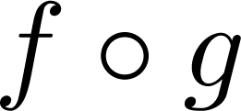
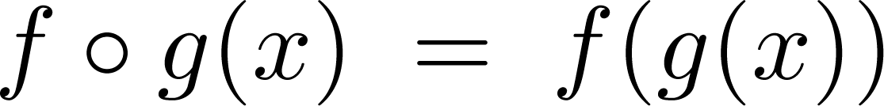
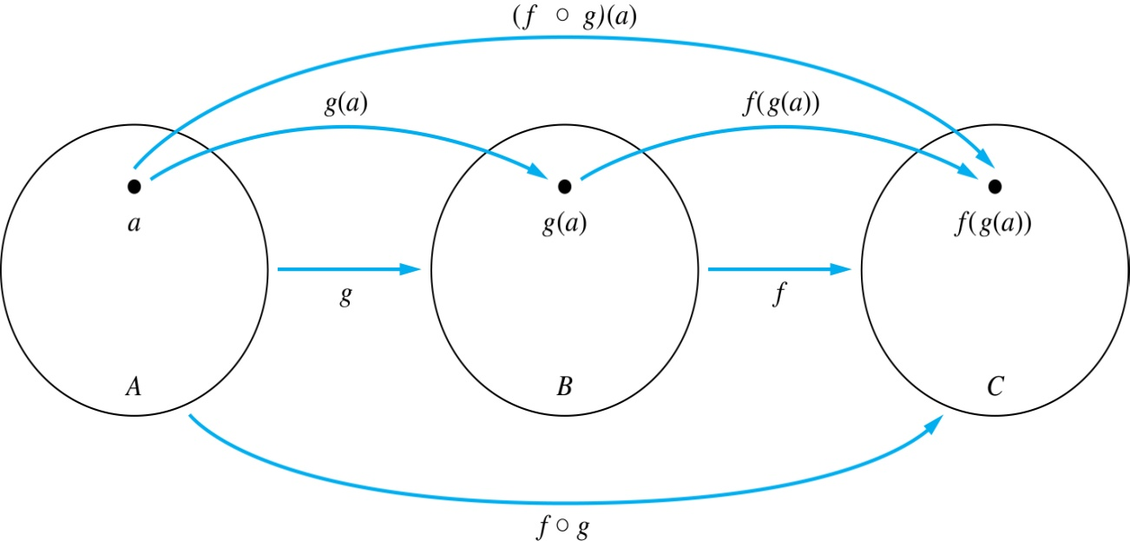
Composition
Definition: Let f: B → C, g: A → B. The composition of f with g, denoted is the function from A to C defined by

Slide 65
Composition
A
g
B
f
C
A
C
V
a
a
h
h
b
i
b
W
i
c
c
X
j
d
d
j
Y

Slide 66
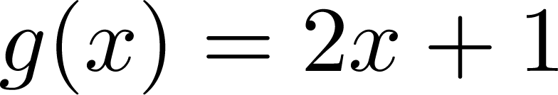
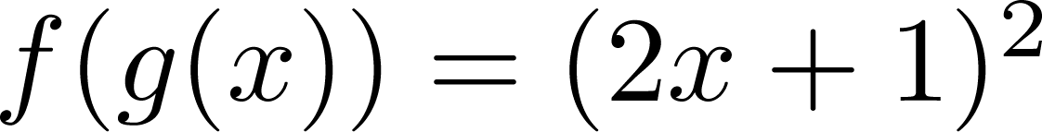
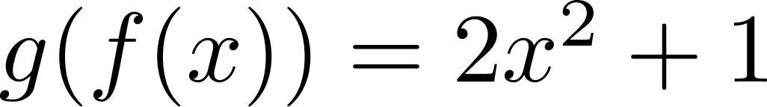
Composition
Example 1: If and , then
and

Slide 67
Composition Questions
Example 2: Let g be the function from the set {a,b,c} to itself such that g(a) = b, g(b) = c, and g(c) = a. Let f be the function from the set {a,b,c} to the set {1,2,3} such that f(a) = 3, f(b) = 2, and f(c) = 1.
What is the composition of f and g, and what is the composition of g and f.
Solution: The composition f∘g is defined by
  f∘g (a)= f(g(a)) = f(b) = 2.
  f∘g (b)= f(g(b)) = f(c) = 1.
  f∘g (c)= f(g(c)) = f(a) = 3.
  Note that g∘f is not defined, because the range of f is not a subset of the domain of g.

Slide 68
Composition Questions
Example 2: Let f and g be functions from the set of integers to the set of integers defined by f(x) = 2x + 3 and g(x) = 3x + 2.
What is the composition of f and g, and also the composition of g and f ?
Solution:
  f∘g (x)= f(g(x)) = f(3x + 2) = 2(3x + 2) + 3 = 6x + 7
  g∘f (x)= g(f(x)) = g(2x + 3) = 3(2x + 3) + 2 = 6x + 11

Slide 69
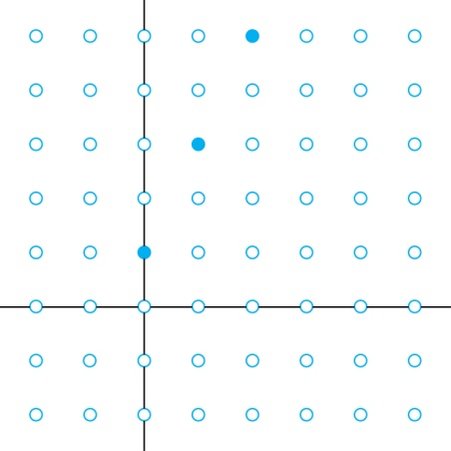
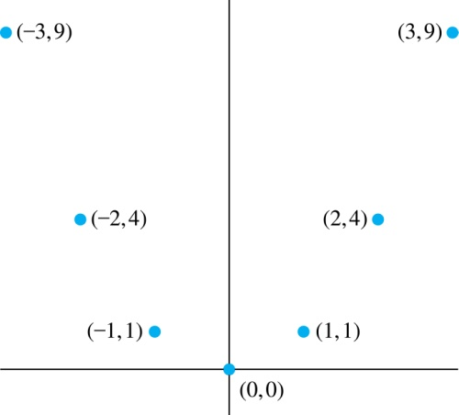
Graphs of Functions
Let f be a function from the set A to the set B. The graph of the function f is the set of ordered pairs {(a,b) | a ∈A and f(a) = b}.
Graph of f(n) = 2n + 1
from Z to Z
Graph of f(x) = x²
from Z to Z

Slide 70
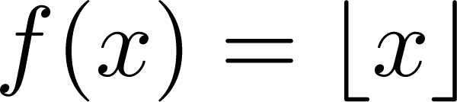
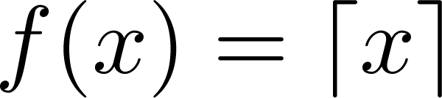
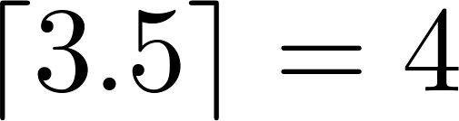
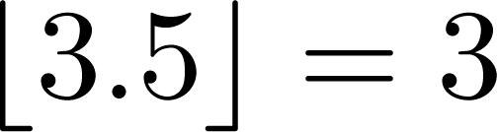
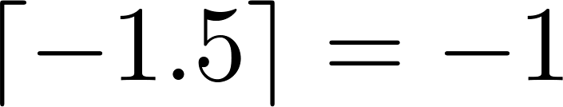
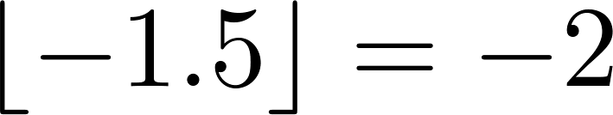
Some Important Functions
The floor function, denoted
is the largest integer less than or equal to x.
The ceiling function, denoted
is the smallest integer greater than or equal to x
Example:

Slide 71
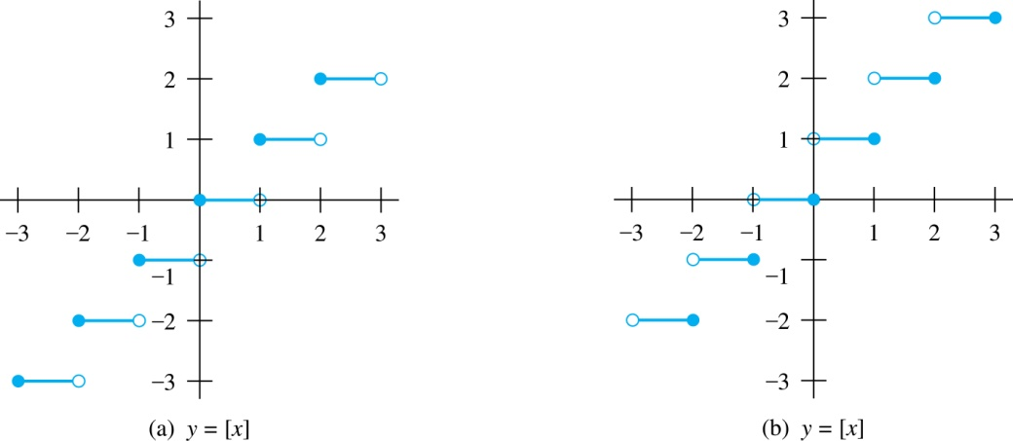
Floor and Ceiling Functions
Graph of (a) Floor and (b) Ceiling Functions

Slide 72
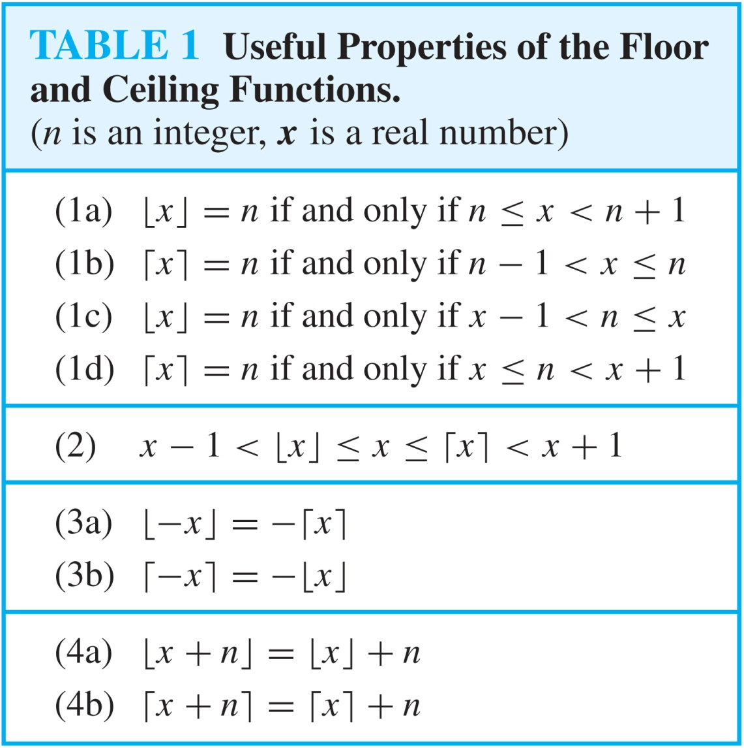
Floor and Ceiling Functions

Slide 73
Proving Properties of Functions
Example: Prove that x is a real number, then
⌊2x⌋= ⌊x⌋ + ⌊x + 1/2⌋
Solution: Let x = n + ε, where n is an integer and 0 ≤ ε< 1.
Case 1: ε < ½
  2x = 2n + 2ε and ⌊2x⌋ = 2n, since 0 ≤ 2ε< 1.
  ⌊x + 1/2⌋ = n, since x + ½ = n + (1/2 + ε ) and 0 ≤ ½ +ε < 1.
  Hence, ⌊2x⌋ = 2n and ⌊x⌋ + ⌊x + 1/2⌋ = n + n = 2n.
Case 2: ε ≥ ½
  2x = 2n + 2ε = (2n + 1) +(2ε − 1) and ⌊2x⌋ =2n + 1, since 0 ≤ 2 ε - 1< 1.
  ⌊x + 1/2⌋ = ⌊ n + (1/2 + ε)⌋ = ⌊ n + 1 + (ε – 1/2)⌋ = n + 1 since 0 ≤ ε – 1/2< 1.
  Hence, ⌊2x⌋ = 2n + 1 and ⌊x⌋ + ⌊x + 1/2⌋ = n + (n + 1) = 2n + 1.

Slide 74
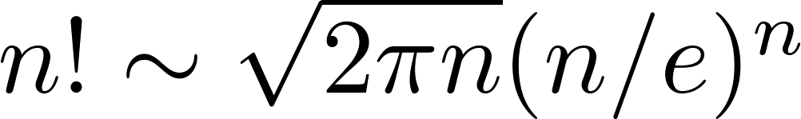
Factorial Function
Definition: f: N → Z⁺ , denoted by f(n) = n! is the product of the first n positive integers when n is a nonnegative integer.
f(n) = 1 ∙ 2 ∙∙∙ (n – 1) ∙ n, f(0) = 0! = 1
Examples:
^{f(1) = 1! = 1}
^{f(2) = 2! = 1 ∙ 2 = 2}
^{f(6) = 6! = 1 ∙ 2 ∙ 3∙ 4∙ 5} ^{∙ 6 = 720}
f(20) = 2,432,902,008,176,640,000.
Stirling’s Formula:

Slide 75
Partial Functions (optional)
Definition: A partial function f from a set A to a set B is an assignment to each element a in a subset of A, called the domain of definition of f, of a unique element b in B.
  The sets A and B are called the domain and codomain of f, respectively.
  We day that f is undefined for elements in A that are not in the domain of definition of f.
  When the domain of definition of f equals A, we say that f is a total function.
Example: f: N → R where f(n) = √n is a partial function from Z to R where the domain of definition is the set of nonnegative integers. Note that f is undefined for negative integers.

Slide 76
Sequences and Summations
Section 2.4

Slide 77
Section Summary
Sequences.
  Examples: Geometric Progression, Arithmetic Progression
Recurrence Relations
  Example: Fibonacci Sequence
Summations
Special Integer Sequences (optional)

Slide 78
Introduction
Sequences are ordered lists of elements.
  1, 2, 3, 5, 8
  1, 3, 9, 27, 81, …….
Sequences arise throughout mathematics, computer science, and in many other disciplines, ranging from botany to music.
We will introduce the terminology to represent sequences and sums of the terms in the sequences.

Slide 79
Sequences
Definition: A sequence is a function from a subset of the integers (usually either the set {0, 1, 2, 3, 4, …..} or {1, 2, 3, 4, ….} ) to a set S.
The notation a_{n} is used to denote the image of the integer n. We can think of a_{n} as the equivalent of f(n) where f is a function from {0,1,2,…..} to S. We call a_{n} a term of the sequence.

Slide 80



Sequences
Example: Consider the sequence where

Slide 81

Geometric Progression
Definition: A geometric progression is a sequence of the form:
where the initial term a and the common ratio r are real numbers.
Examples:
  Let a = 1 and r = −1. Then:
  Let a = 2 and r = 5. Then:
  Let a = 6 and r = 1/3. Then:

Slide 82
Arithmetic Progression
Definition: A arithmetic progression is a sequence of the form:
where the initial term a and the common difference d are real numbers.
Examples:
  Let a = −1 and d = 4:
  Let a = 7 and d = −3:
  Let a = 1 and d = 2:

Slide 83
Strings
Definition: A string is a finite sequence of characters from a finite set (an alphabet).
Sequences of characters or bits are important in computer science.
The empty string is represented by λ.
The string abcde has length 5.

Slide 84
Recurrence Relations
Definition: A recurrence relation for the sequence {a_{n}} is an equation that expresses a_{n} in terms of one or more of the previous terms of the sequence, namely, a₀, a₁, …, a_{n-1}, for all integers n with n ≥ n₀, where n₀ is a nonnegative integer.
A sequence is called a solution of a recurrence relation if its terms satisfy the recurrence relation.
The initial conditions for a sequence specify the terms that precede the first term where the recurrence relation takes effect.

Slide 85
Questions about Recurrence Relations
Example 1: Let {a_{n}} be a sequence that satisfies the recurrence relation a_{n} = a_{n-1} + 3 for n = 1,2,3,4,…. and suppose that a₀ = 2. What are a₁ , a₂ and a₃?
[Here a₀ = 2 is the initial condition.]
  Solution: We see from the recurrence relation that
  a₁ = a₀ + 3 = 2 + 3 = 5
  a₂ = 5 + 3 = 8
  a₃ = 8 + 3 = 11

Slide 86
Questions about Recurrence Relations
Example 2: Let {a_{n}} be a sequence that satisfies the recurrence relation a_{n} = a_{n-1} – a_{n-2} for n = 2,3,4,…. and suppose that a₀ = 3 and a₁ = 5. What are a₂ and a₃?
[Here the initial conditions are a₀ = 3 and a₁ = 5. ]
Solution: We see from the recurrence relation that
a₂ = a₁ - a₀ = 5 – 3 = 2
a₃ = a₂ – a₁ = 2 – 5 = –3

Slide 87
Fibonacci Sequence
Definition: Define the Fibonacci sequence, f₀ ,f₁ ,f₂,…, by:
  Initial Conditions: f₀ = 0, f₁ = 1
  Recurrence Relation: f_{n} = f_{n-1} + f_{n-2}
Example: Find f₂ ,f₃ ,f₄ , f₅ and f₆ .
Answer:
f₂ = f₁ + f₀ = 1 + 0 = 1,
f₃ = f₂ + f₁ = 1 + 1 = 2,
f₄ = f₃ + f₂ = 2 + 1 = 3,
f₅ = f₄ + f₃ = 3 + 2 = 5,
f₆ = f₅ + f₄ = 5 + 3 = 8.

Slide 88
Solving Recurrence Relations
Finding a formula for the nth term of the sequence generated by a recurrence relation is called solving the recurrence relation.
Such a formula is called a closed formula.
Various methods for solving recurrence relations will be covered in Chapter 8 where recurrence relations will be studied in greater depth.
Here we illustrate by example the method of iteration in which we need to guess the formula. The guess can be proved correct by the method of induction (Chapter 5).

Slide 89
Iterative Solution Example
Method 1: Working upward, forward substitution
Let {a_{n}} be a sequence that satisfies the recurrence relation a_{n} = a_{n-1} + 3 for n = 2,3,4,…. and suppose that a₁ = 2.
  a₂ = 2 + 3
  a₃ = (2 + 3) + 3 = 2 + 3 ∙ 2
  a₄ = (2 + 2 ∙ 3) + 3 = 2 + 3 ∙ 3
  .
  .
  .
a_{n} = a_{n-1} + 3 = (2 + 3 ∙ (n – 2)) + 3 = 2 + 3(n – 1)

Slide 90
Iterative Solution Example
Method 2: Working downward, backward substitution
Let {a_{n}} be a sequence that satisfies the recurrence relation a_{n} = a_{n-1} + 3 for n = 2,3,4,…. and suppose that a₁ = 2.
a_{n} = a_{n-1} + 3
= (a_{n-2} + 3) + 3 = a_{n-2} + 3 ∙ 2
  = (a_{n-3} + 3 )+ 3 ∙ 2 = a_{n-3} + 3 ∙ 3
  .
  .
  .
= a₂ + 3(n – 2) = (a₁ + 3) + 3(n – 2) = 2 + 3(n – 1)

Slide 91
Financial Application
Example: Suppose that a person deposits $10,000.00 in a savings account at a bank yielding 11% per year with interest compounded annually. How much will be in the account after 30 years?
Let P_{n} denote the amount in the account after 30 years. P_{n} satisfies the following recurrence relation:
P_{n} = P_{n-1} + 0.11P_{n-1} = (1.11) P_{n-1}
with the initial condition P₀ = 10,000
Continued on next slide →

Slide 92
Financial Application
P_{n} = P_{n-1} + 0.11P_{n-1} = (1.11) P_{n-1}
with the initial condition P₀ = 10,000
Solution: Forward Substitution
P₁ = (1.11)P₀
P₂ = (1.11)P₁ = (1.11)²P₀
P₃ = (1.11)P₂ = (1.11)³P₀
:
P_{n} = (1.11)P_{n-1} = (1.11)^{n}P₀ = (1.11)^{n} 10,000
P_{n} = (1.11)^{n} 10,000 (Can prove by induction, covered in Chapter 5)
P₃₀ = (1.11)³⁰ 10,000 = $228,992.97

Slide 93
Special Integer Sequences (opt)
Given a few terms of a sequence, try to identify the sequence. Conjecture a formula, recurrence relation, or some other rule.
Some questions to ask?
  Are there repeated terms of the same value?
  Can you obtain a term from the previous term by adding an amount or multiplying by an amount?
  Can you obtain a term by combining the previous terms in some way?
  Are they cycles among the terms?
  Do the terms match those of a well known sequence?

Slide 94
Questions on Special Integer Sequences (opt)
Example 1: Find formulae for the sequences with the following first five terms: 1, ½, ¼, 1/8, 1/16
Solution: Note that the denominators are powers of 2. The sequence with a_{n} = 1/2^{n} is a possible match. This is a geometric progression with a = 1 and r = ½.
Example 2: Consider 1,3,5,7,9
Solution: Note that each term is obtained by adding 2 to the previous term. A possible formula is a_{n} = 2n + 1. This is an arithmetic progression with a =1 and d = 2.
Example 3: 1, -1, 1, -1,1
Solution: The terms alternate between 1 and -1. A possible sequence is a_{n} = (−1)^{n} . This is a geometric progression with a = 1 and r = −1.

Slide 95

Useful Sequences

Slide 96
Guessing Sequences (optional)
Example: Conjecture a simple formula for a_{n} if the first 10 terms of the sequence {a_{n}} are 1, 7, 25, 79, 241, 727, 2185, 6559, 19681, 59047.
Solution: Note the ratio of each term to the previous approximates 3. So now compare with the sequence 3^{n} . We notice that the nth term is 2 less than the corresponding power of 3. So a good conjecture is that a_{n} = 3^{n} − 2.

Slide 97
Integer Sequences (optional)
Integer sequences appear in a wide range of contexts. Later we will see the sequence of prime numbers (Chapter 4), the number of ways to order n discrete objects (Chapter 6), the number of moves needed to solve the Tower of Hanoi puzzle with n disks (Chapter 8), and the number of rabbits on an island after n months (Chapter 8).
Integer sequences are useful in many fields such as biology, engineering, chemistry and physics.
On-Line Encyclopedia of Integer Sequences (OESIS) contains over 200,000 sequences. Began by Neil Stone in the 1960s (printed form). Now found at http://oeis.org/Spuzzle.html

Slide 98
Integer Sequences (optional)
Here are three interesting sequences to try from the OESIS site. To solve each puzzle, find a rule that determines the terms of the sequence.
Guess the rules for forming for the following sequences:
  2, 3, 3, 5, 10, 13, 39, 43, 172, 177, ...
    Hint: Think of adding and multiplying by numbers to generate this sequence.
  0, 0, 0, 0, 4, 9, 5, 1, 1, 0, 55, ...
    Hint: Think of the English names for the numbers representing the position in the sequence and the Roman Numerals for the same number.
  2, 4, 6, 30, 32, 34, 36, 40, 42, 44, 46, ...
    Hint: Think of the English names for numbers, and whether or not they have the letter ‘e.’
The answers and many more can be found at
http://oeis.org/Spuzzle.html

Slide 99




Summations
Sum of the terms
from the sequence
The notation:
represents
The variable j is called the index of summation. It runs through all the integers starting with its lower limit m and ending with its upper limit n.

Slide 100




Summations
More generally for a set S:
Examples:

Slide 101



Product Notation (optional)
Product of the terms
from the sequence
The notation:
represents

Slide 102




Geometric Series
Sums of terms of geometric progressions
To compute S_{n} , first multiply both sides of the equality by r and then manipulate the resulting sum as follows:
Proof:
Let
Continued on next slide →

Slide 103






Geometric Series
From previous slide.
Shifting the index of summation with k = j + 1.
Removing k = n + 1 term and
adding k = 0 term.
Substituting S for summation formula
∴
if r ≠1
if r = 1

Slide 104

Some Useful Summation Formulae
Geometric Series: We just proved this.
Later we will prove some of these by induction.
Proof in text
(requires calculus)

Slide 105
Cardinality of Sets
Section 2.5

Slide 106
Section Summary
Cardinality
Countable Sets
Computability

Slide 107
Cardinality
Definition: The cardinality of a set A is equal to the cardinality of a set B, denoted
|A| = |B|,
if and only if there is a one-to-one correspondence (i.e., a bijection) from A to B.
If there is a one-to-one function (i.e., an injection) from A to B, the cardinality of A is less than or the same as the cardinality of B and we write |A| ≤ |B|.
When |A| ≤ |B| and A and B have different cardinality, we say that the cardinality of A is less than the cardinality of B and write |A| < |B|.

Slide 108
Cardinality
Definition: A set that is either finite or has the same cardinality as the set of positive integers (Z⁺) is called countable. A set that is not countable is uncountable.
The set of real numbers R is an uncountable set.
When an infinite set is countable (countably infinite) its cardinality is ℵ₀ (where ℵ is aleph, the 1st letter of the Hebrew alphabet). We write |S| = ℵ₀ and say that S has cardinality “aleph null.”

Slide 109
Showing that a Set is Countable
An infinite set is countable if and only if it is possible to list the elements of the set in a sequence (indexed by the positive integers).
The reason for this is that a one-to-one correspondence f from the set of positive integers to a set S can be expressed in terms of a sequence a₁,a₂,…, a_{n} ,… where a₁ = f(1), a₂ = f(2),…, a_{n} = f(n),…

Slide 110


Hilbert’s Grand Hotel
David Hilbert
The Grand Hotel (example due to David Hilbert) has countably infinite number of rooms, each occupied by a guest. We can always accommodate a new guest at this hotel. How is this possible?
Explanation: Because the rooms of Grand Hotel are countable, we can list them as Room 1, Room 2, Room 3, and so on. When a new guest arrives, we move the guest in Room 1 to Room 2, the guest in Room 2 to Room 3, and in general the guest in Room n to Room n + 1, for all positive integers n. This frees up Room 1, which we assign to the new guest, and all the current guests still have rooms.
The hotel can also accommodate a countable number of new guests, all the guests on a countable number of buses where each bus contains a countable number of guests (see exercises).

Slide 111
Showing that a Set is Countable
Example 1: Show that the set of positive even integers E is countable set.
Solution: Let f(x) = 2x.
1 2 3 4 5 6 …..
2 4 6 8 10 12 ……
Then f is a bijection from N to E since f is both one-to-one and onto. To show that it is one-to-one, suppose that f(n) = f(m). Then 2n = 2m, and so n = m. To see that it is onto, suppose that t is an even positive integer. Then t = 2k for some positive integer k and f(k) = t.

Slide 112
Showing that a Set is Countable
Example 2: Show that the set of integers Z is countable.
Solution: Can list in a sequence:
0, 1, − 1, 2, − 2, 3, − 3 ,………..
Or can define a bijection from N to Z:
  When n is even: f(n) = n/2
  When n is odd: f(n) = −(n−1)/2

Slide 113
The Positive Rational Numbers are Countable
Definition: A rational number can be expressed as the ratio of two integers p and q such that q ≠ 0.
  ¾ is a rational number
  √2 is not a rational number.
Example 3: Show that the positive rational numbers are countable.
Solution:The positive rational numbers are countable since they can be arranged in a sequence:
r₁ , r₂ , r₃ ,…
The next slide shows how this is done. →

Slide 114

The Positive Rational Numbers are Countable
First row q = 1.
Second row q = 2.
etc.
Constructing the List
First list p/q with p + q = 2.
Next list p/q with p + q = 3
And so on.
1, ½, 2, 3, 1/3,1/4, 2/3, ….

Slide 115
Strings
Example 4: Show that the set of finite strings S over a finite alphabet A is countably infinite.
  Assume an alphabetical ordering of symbols in A
Solution: Show that the strings can be listed in a sequence. First list
  All the strings of length 0 in alphabetical order.
  Then all the strings of length 1 in lexicographic (as in a dictionary) order.
  Then all the strings of length 2 in lexicographic order.
  And so on.
This implies a bijection from N to S and hence it is a countably infinite set.

Slide 116
The set of all Java programs is countable.
Example 5: Show that the set of all Java programs is countable.
Solution: Let S be the set of strings constructed from the characters which can appear in a Java program. Use the ordering from the previous example. Take each string in turn:
  Feed the string into a Java compiler. (A Java compiler will determine if the input program is a syntactically correct Java program.)
  If the compiler says YES, this is a syntactically correct Java program, we add the program to the list.
  We move on to the next string.
In this way we construct an implied bijection from N to the set of Java programs. Hence, the set of Java programs is countable.

Slide 117


The Real Numbers are Uncountable
Georg Cantor
(1845-1918)
Example: Show that the set of real numbers is uncountable.
Solution: The method is called the Cantor diagnalization argument, and is a proof by contradiction.
Suppose R is countable. Then the real numbers between 0 and 1 are also countable (any subset of a countable set is countable - an exercise in the text).
The real numbers between 0 and 1 can be listed in order r₁ , r₂ , r₃ ,… .
Let the decimal representation of this listing be
Form a new real number with the decimal expansion
where
r is not equal to any of the r₁ , r₂ , r₃ ,... Because it differs from r_{i} in its ith position after the decimal point. Therefore there is a real number between 0 and 1 that is not on the list since every real number has a unique decimal expansion. Hence, all the real numbers between 0 and 1 cannot be listed, so the set of real numbers between 0 and 1 is uncountable.
Since a set with an uncountable subset is uncountable (an exercise), the set of real numbers is uncountable.

Slide 118
Computability (Optional)
Definition: We say that a function is computable if there is a computer program in some programming language that finds the values of this function. If a function is not computable we say it is uncomputable.
There are uncomputable functions. We have shown that the set of Java programs is countable. Exercise 38 in the text shows that there are uncountably many different functions from a particular countably infinite set (i.e., the positive integers) to itself. Therefore (Exercise 39) there must be uncomputable functions.

Slide 119
Matrices
Section 2.6

Slide 120
Section Summary
Definition of a Matrix
Matrix Arithmetic
Transposes and Powers of Arithmetic
Zero-One matrices

Slide 121
Matrices
Matrices are useful discrete structures that can be used in many ways. For example, they are used to:
  describe certain types of functions known as linear transformations.
  Express which vertices of a graph are connected by edges (see Chapter 10).
In later chapters, we will see matrices used to build models of:
  Transportation systems.
  Communication networks.
Algorithms based on matrix models will be presented in later chapters.
Here we cover the aspect of matrix arithmetic that will be needed later.

Slide 122


Matrix
Definition: A matrix is a rectangular array of numbers. A matrix with m rows and n columns is called an m n matrix.
  The plural of matrix is matrices.
  A matrix with the same number of rows as columns is called square.
  Two matrices are equal if they have the same number of rows and the same number of columns and the corresponding entries in every position are equal.
3 2 matrix

Slide 123


Notation
Let m and n be positive integers and let
The ith row of A is the 1 n matrix [a_{i1}, a_{i2},…,a_{in}]. The jth column of A is the m 1 matrix:
The (i,j)th element or entry of A is the
element a_{ij}. We can use A = [a_{ij} ] to denote the matrix with its (i,j)th element equal to a_{ij}.

Slide 124

Matrix Arithmetic: Addition
Defintion: Let A = [a_{ij}] and B = [b_{ij}] be m n matrices. The sum of A and B, denoted by A + B, is the m n matrix that has a_{ij} + b_{ij} as its (i,j)th element. In other words, A + B = [a_{ij} + b_{ij}].
Example:
Note that matrices of different sizes can not be added.

Slide 125

Matrix Multiplication
Definition: Let A be an m k matrix and B be a k n matrix. The product of A and B, denoted by AB, is the m n matrix that has its (i,j)th element equal to the sum of the products of the corresponding elements from the ith row of A and the jth column of B. In other words, if AB = [c_{ij}] then c_{ij} = a_{i1}b_{1j} + a_{i2}b_{2j} + … + a_{kj}b_{2j}.
Example:
The product of two matrices is undefined when the number of columns in the first matrix is not the same as the number of rows in the second.

Slide 126



Illustration of Matrix Multiplication
The Product of A = [a_{ij}] and B = [b_{ij}]

Slide 127




Matrix Multiplication is not Commutative
Example: Let
Does AB = BA?
Solution:
AB ≠ BA

Slide 128

Identity Matrix and Powers of Matrices
Definition: The identity matrix of order n is the m n matrix I_{n} = [δ_{ij}], where δ_{ij} = 1 if i = j and δ_{ij} = 0 if i≠j.
AI_{n} = I_{m}A = A
when A is an m n matrix
Powers of square matrices can be defined. When A is an n × n matrix, we have:
A⁰ = I_{n} A^{r} = AAA∙∙∙A
r times

Slide 129

Transposes of Matrices
Definition: Let A = [a_{ij}] be an m n matrix. The transpose of A, denoted by A^{t} ,is the n m matrix obtained by interchanging the rows and columns of A.
  If A^{t} = [b_{ij}], then b_{ij} = a_{ji} for i =1,2,…,n and j = 1,2, ...,m.

Slide 130

Transposes of Matrices
Definition: A square matrix A is called symmetric if A = A^{t}. Thus A = [a_{ij}] is symmetric if a_{ij} = a_{ji} for i and j with 1≤ i≤ n and 1≤ j≤ n.
Square matrices do not change when their rows and columns are interchanged.

Slide 131


Zero-One Matrices
Definition: A matrix all of whose entries are either 0 or 1 is called a zero-one matrix. (These will be used in Chapters 9 and 10.)
Algorithms operating on discrete structures represented by zero-one matrices are based on Boolean arithmetic defined by the following Boolean operations:

Slide 132
Zero-One Matrices
Definition: Let A = [a_{ij}] and B = [b_{ij}] be an m × n zero-one matrices.
  The join of A and B is the zero-one matrix with (i,j)th entry a_{ij} ∨ b_{ij}. The join of A and B is denoted by A ∨ B.
  The meet of of A and B is the zero-one matrix with (i,j)th entry a_{ij} ∧ b_{ij}. The meet of A and B is denoted by A ∧ B.

Slide 133




Joins and Meets of Zero-One Matrices
Example: Find the join and meet of the zero-one matrices
Solution: The join of A and B is
The meet of A and B is

Slide 134


Boolean Product of Zero-One Matrices
Definition: Let A = [a_{ij}] be an m k zero-one matrix and B = [b_{ij}] be a k n zero-one matrix. The Boolean product of A and B, denoted by A ⊙ B, is the m n zero-one matrix with(i,j)th entry
  c_{ij} = (a_{i1} ∧ b_{1j})∨ (a_{i2} ∧ b_{2j}) ∨ … ∨ (a_{ik} ∧ b_{kj}).
Example: Find the Boolean product of A and B, where
Continued on next slide →

Slide 135



Boolean Product of Zero-One Matrices
Solution: The Boolean product A ⊙ B is given by

Slide 136

Boolean Powers of Zero-One Matrices
Definition: Let A be a square zero-one matrix and let r be a positive integer. The rth Boolean power of A is the Boolean product of r factors of A, denoted by A^{[r]} . Hence,
We define A^{[r]} to be I_{n}.
(The Boolean product is well defined because the Boolean product of matrices is associative.)

Slide 137





Boolean Powers of Zero-One Matrices
Example: Let
Find A^{n} for all positive integers n.
Solution:

